Slide 1


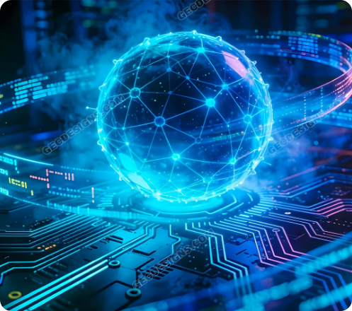
PROFESSIONAL CERTIFICATION TRACK
Applied AI & Deep Learning Engineering
A comprehensive 16-week, 144-hour mastery program taking candidates from foundations to production-grade AI systems.
144 Hours
4 Capstones
48 Live Hands-On Sessions
Production System Builds
Level 0 Friendly
PyTorch & MLOps Stack

Slide 2



TARGET AUDIENCE & PREREQUISITES
Accessible to Beginners, Built for Career Growth
Absolute Beginners
Career Switchers
Software & IT Pros
No prior coding background required. Structured introduction to logic and Python.
Transition into high-salary tech roles with a battle-tested industrial portfolio.
Upgrade traditional engineering skills to modern PyTorch, MLOps, and Generative AI.
Prerequisite Requirements
100% Zero-Level Inclusive
Basic laptop setup & commitment. All development environments are configured live during sessions.

Slide 3
SEQUENTIAL LEARNING PROGRESSION
16-Week Curriculum Roadmap
MODULE 01 • SESSIONS 01-12 (36 HRS)
MODULE 02 • SESSIONS 13-24 (36 HRS)
Python & Engineering Foundations
Core Machine Learning Depth
Git workflows, OOP, NumPy, Pandas & Math primitives.
Supervised models, XGBoost, Scikit-Learn pipelines & PCA.
Capstone 1: Automated Data CLI
Capstone 2: End-to-End ML Pipeline
MODULE 03 • SESSIONS 25-36 (36 HRS)
MODULE 04 • SESSIONS 37-48 (36 HRS)
Core Deep Learning (PyTorch)
Applied AI Specialization Pathways
Autograd, custom neural nets, CNNs & Transfer Learning.
FastAPI, Computer Vision (YOLO), NLP & GenAI (RAG).
Capstone 3: PyTorch Deep Classifier
Capstone 4: Applied Pathway Showcase

Slide 4
CAREER IMPACT & TARGET ROLES
Market Outcomes & High-Value Positions
Production AI Deployment
CAREER MARKET ALIGNMENT
1
Target High-Value Job Roles
Ship models as REST APIs using Docker containers and PyTorch workflows.
AI Systems Engineer
2
4 End-to-End Capstone Portfolio
Demonstrate production-grade GitHub code to tech recruiters and hiring teams.
Deep Learning Specialist
Applied Machine Learning Engineer
3
Enterprise Stack Mastery
Hands-on fluency in PyTorch, Scikit-Learn, OpenCV, NLP,Rag,& Hugging Face.
Generative AI Solutions & MLOps Developer

